Slide 1
Encapsulating Core Functionality using JSP Standard Tag Library(JSTL)

Slide 2
Loop
Condition Execution Database Access Internationalization XML Processing
JSTL
Features

Slide 3
JSP Standard Tag Library(JSTL)
Core Tags
Formatting Tags
Database Tags
Functions Tags
XML Tags

Slide 6
Core Tags

Slide 7
<@taglib prefix="C“ the uri=
" http://java.sun.com/jsp/jstl/core" %>
Syntax
JSTL Core tags

Slide 8
<c:out>
<c:set>
<c:remove>
<c:catch>
<c:if>
<c:choose>
<c:when>
<c:otherwise>
<c:import>
<c:foreach>
<c:forTokens>
<c:param>
<c:redirect>
<c:url>
JSTL
Core Tags

Slide 13
Formatting Tags

Slide 14
<@taglib prefix="fmt" the uri=" http://java.sun.com/jsp/jstl/fmt " %>
Syntax
To use the JSTL Formatting tags

Slide 15
<fmt:formatNumber>
<fmt:parseNumber>
<fmt:formatDate>
<fmt:parseDate>
<fmt:bundle>
<fmt:setLocale>
<fmt:setBundle>
<fmt:timeZone>
<fmt:setTimeZone>
<fmt:message>
<fmt:requestEncoding>
JSTL
Formatting Tags

Slide 18
SQL Tags

Slide 19
<% taglib prefix="sql" uri ="http://java.sun.com/jsp/jstl/sql" %>
Syntax
To include the JSTL SQL tag library

Slide 20
<sql:setDataSource>
<sql:query>
<sql:update>
<sql:param>
<sql:dateParam>
<sql:transaction>
JSTL
SQL Tags

Slide 23
JSTL Functions

Slide 24
<%@ taglib prefix="fn" uri="http://java.sun.com/jsp/jstl/function" %>
Syntax
To include the JSTL Function tag library

Slide 25
fn:contains fn:containsIgnoreCase fn:endsWith
fn:indexOf fn:join fn:length fn:split fn:startsWith fn:substring fn:toUpperCase fn:toLowerCase fn:trim
JSTL
Function Tags

Slide 27
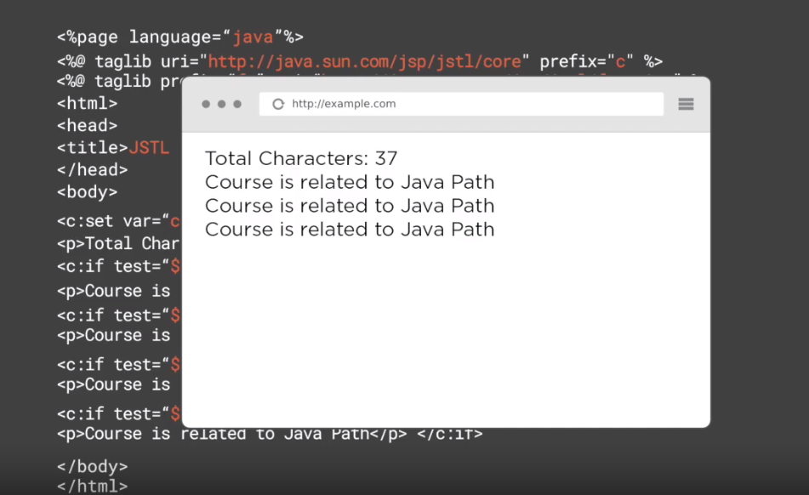

Slide 28

Assisted Practice
Extending Virtual Training Company Application Using JSTL

Slide 29

Working with JSTL
Core Tags Formatting Tags SQL Tags
Summary
JSTL Functions

